Slide 1
Kan vi stole på test?
Guido Makransky
Senior pychometrician: Master Management International
Ph.D. student: University of Twente, Holland

Slide 2

Overview
What is faking/cheating?
How often do people fake/cheat?
When and who fakes/cheats?
Methods used to limit faking/cheating.
Methods used to catch fakers/cheaters.
Recommendations and best practice.

Slide 3
Prevalence of faking
About 1 out of every 4 people fake in a high-stakes situation (Mccann et al., 2011)
  45% of job applicants falsify work histories (Burke, 2009)
  About half of all college students report cheating on an exam (Cizek, 1999)
Medical or neuropsychological conditions 20 to 40%
Personal injury cases 30%
Disability claims 30%

Slide 4
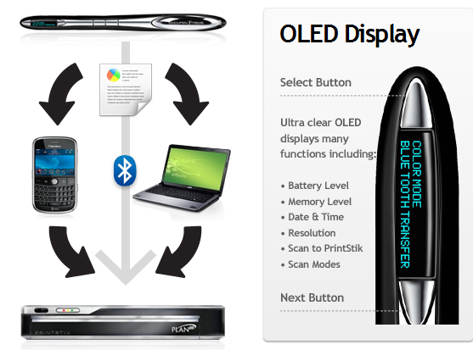
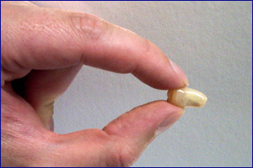
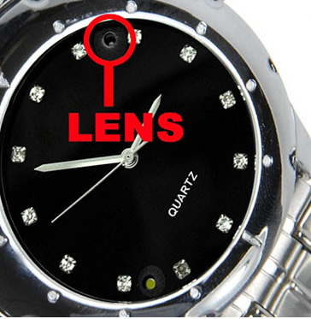
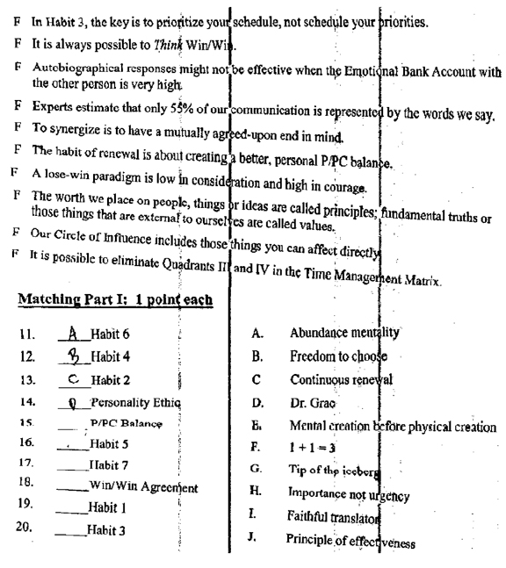
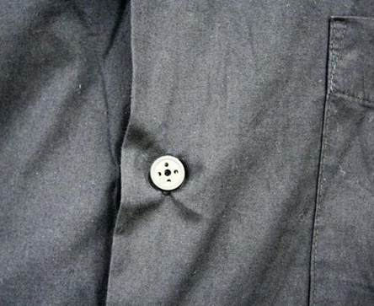
Examples of cheating tools

Slide 5
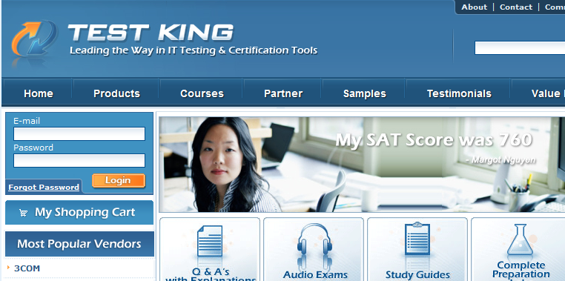
Examples of cheating tools

Slide 6

  What is cheating?
  An attempt, by deception or fraudulent means, to represent oneself as possessing knowledge that one does not actually possess
                (Cizek, 1999, p.3)

Slide 7
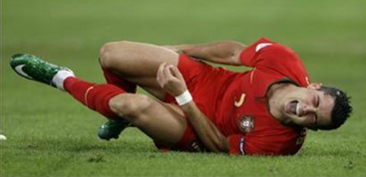
What is faking?
Not considered faking
  Impression management
  Erroneous self-perception
What is faking?
  A behavior not a trait
  Goal oriented
  Results in an inaccurate impression
  Faking is intentional behavior
  Involves interaction of person and situation factors
    A person who fakes in one setting will not necessarily fake in all settings
    Not everyone will fake just because they have a reason to

Slide 8

Some correlates to faking/cheating
Situational factors:
  Knowledge of the job requirements
  Knowledge of how the test will be used
  Importance of the outcome
Personal factors:
  Age (Diekhoff; Graham and Haines)
  Lack of conscientiousness
  Integrity
  Emotional intelligence
Other factors:
  Culture

Slide 9
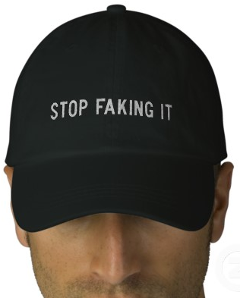
Methods used to limit faking
Warnings
  Feedback interviews
Test design
  Verifiable responses
    “I take on extra work” vs. “How many hours of overtime did you perform last month?”
  Manipulations of item desirability
  Forced choice tests

Slide 10
When there is no control cheating increases
Cheating increases when:
  Decreased level of surveillance by proctor (Covey et al., 1989)
  Unproctored examination (Sierles et al., 1988)
  Instructor leaving the room during testing (Steininger et al., 1964)
  Reduced supervision (Leming, 1978)

Slide 11

Traditional method to prevent cheating
Proctoring
  Instructors as proctors caught less than 1% of cheaters (Fishbein, 1994)
  1.3% of undergraduate cheaters are caught (Haines et al., 1986)
  20% of professors ignored obvious cheating (Murray, 1996)

Slide 12

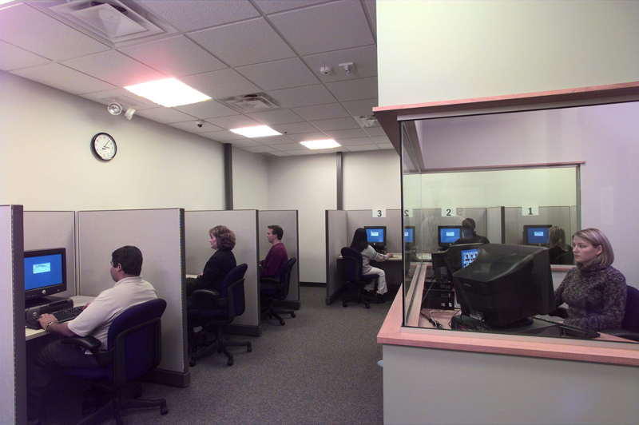
New methods to prevent cheating
Remotely proctored testing stations

Slide 13

Test construction methods used to catch fakers
Social desirability scales
Bogus items
Decision trees

Slide 14
Methods used to catch cheaters in maximum potential tests
Statistical analyses
  Item time
  Collusion

Slide 15


New challenges
Unproctored Internet delivered tests (UIT)
UIT accounts for the majority of individual employment test administrations in the private sector
Follow-up/confirmation tests
    A confirmation test is a short computerized test given under supervision to verify the result obtained in an online test

Slide 16


CAT Confirmation testing
Max number of items: 8
Stops test after as few as: 3 items
Average test length 7 minutes (max 15)
Three possible results
  UIT test result confirmed:
  New test recommended:
  UIT test result rejected:

Slide 17
Results
1000 job candidates
100 of them cheated (cheating effect = 2 sd units).
Makransky and Glas (2010)
Result | Honest Respondents | Cheaters
 | 855 | 5
 | 45 | 50
 | 0 | 45

Slide 18
Recommendations “Best practice” personality tests
Do not use social desirability scales
Interpret scores cautiously when existing detection methods suggest faking
Implement strategies designed to minimize faking
Test developers should consider implementing formal processes to limit faking
Use personality scales as a “screen-out” rather than a “screen-in” tool
Recommendations from Ziegler et. al., 2011.

Slide 19
Recommendations “Best practice” maximum potential tests
Implement procedures to reduce the opportunity for cheating
Require applicants who obtain qualifying scores in an unsupervised test to take a supervised test to confirm their scores
  Check whether the test-taker’s scores are consistent
  Inform test-takers in advance of these procedures
Provide test-takers with a list of expectations and consequences for fraudulent test taking practices, and require test-takers to accept
International Guidelines on Computer-Based and Internet Delivered Testing, 2005

Slide 20

Tak!
Contact info: Guidomakransky@gmail.com

